Slide 1

경제의 디지털화와 성장$∙$분배 김영식 (서울대 경제학부)

Slide 2
https://www.youtube.com/watch?v=QfMGyCk3XTw

Slide 4
Race Against The Machine
Employment is taking longer and longer to recover from a recession
Recessions always increase joblessness, but between May 2007 and October 2009 unemployment jumped by more than 5.7 percentage points, the largest increase in the postwar period.

Slide 5
Race Against The Machine

Slide 6
Race Against The Machine
The Digitization of the Economy
Computers are getting dramatically cheaper and more powerful

Slide 7
Race Against The Machine
The Digitization of the Economy
IT Investment

Slide 8
Race Against The Machine
Economic Consequences of Rapid Digitization
The Hard Truth

Slide 9
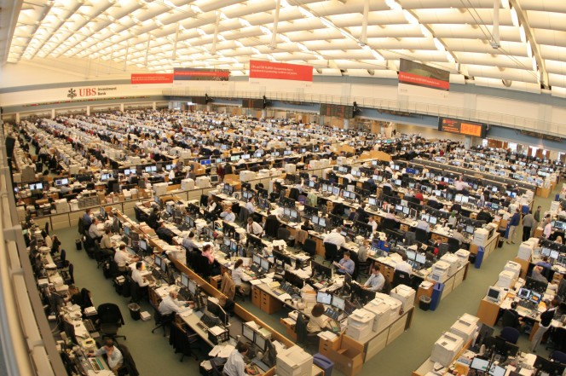
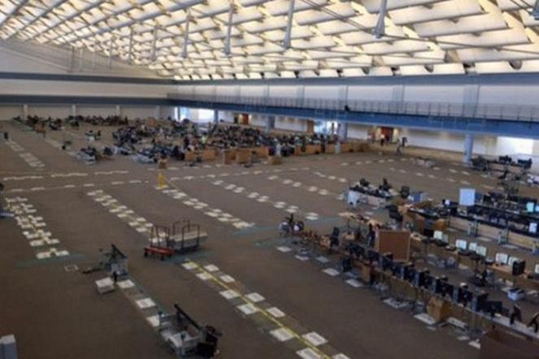
FinTech
UBS’s trading floor, Stamford, Ct., USA
2005
2016
출처: Yermack, D. “Blockchain and the Future of Finance -what problems do blockchains solve?” https://research.chicagobooth.edu/stigler/events#lecture-2017

Slide 10
Race Against The Machine
Economic Consequences of Rapid Digitization
The Great Decoupling

Slide 11
Race Against The Machine
Three Sets of Winners and Losers
High Skilled vs. Low & Mid Skilled Workers

Slide 12
Race Against The Machine
Three Sets of Winners and Losers
High Skilled vs. Low & Mid Skilled Workers

Slide 13
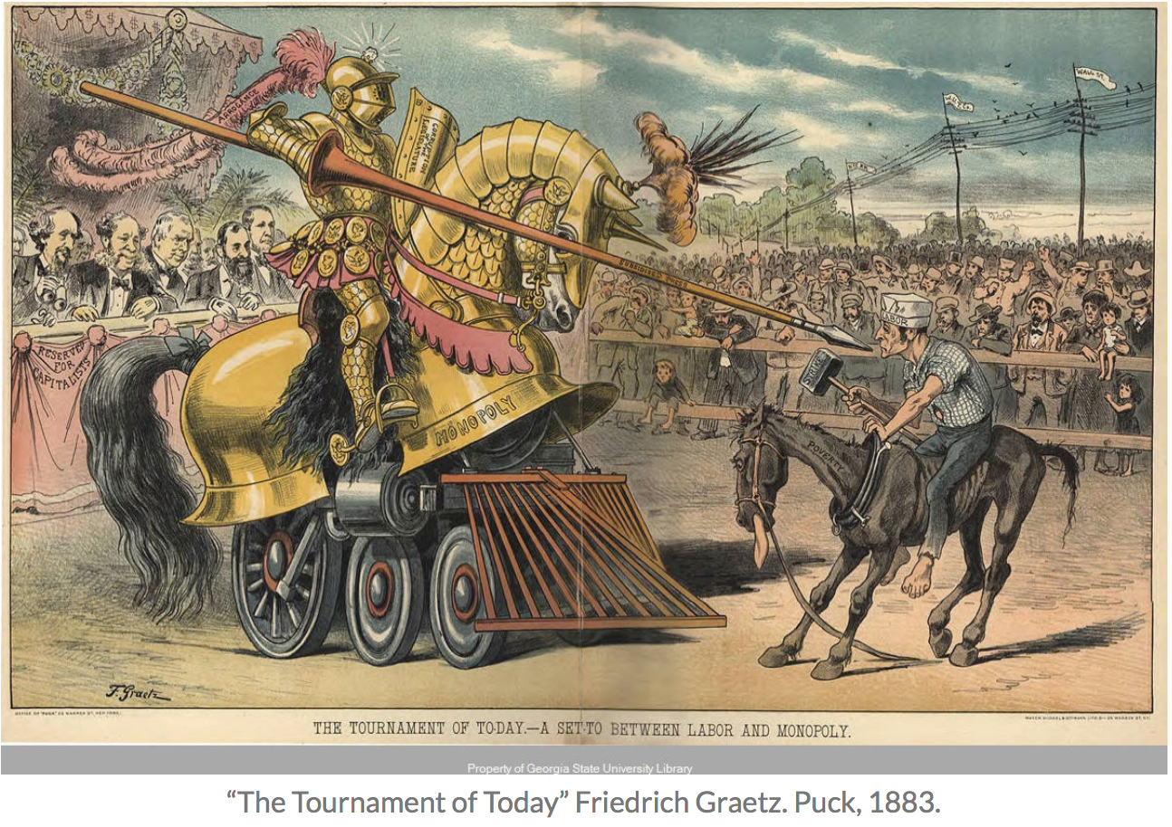
Race Against The Machine
Three Sets of Winners and Losers
Capital vs. Labor
https://toonintoday.wordpress.com/2017/04/30/labor-vs-capital/

Slide 14
Race Against The Machine
Three Sets of Winners and Losers
Capital vs. Labor

Slide 15
Race Against The Machine
Three Sets of Winners and Losers
Superstars vs. Everyone Else

Slide 16
Race Against The Machine
But if humans and machines work together, everyone wins!
Weak human + machine + better process was superior to a strong computer alone and, more remarkably, superior to a strong human + machine + inferior process.
Technology enables more and more opportunities for what Google chief economist Hal Varian calls “micro-multinationals”—businesses with less than a dozen employees that sell to customers worldwide and often draw on worldwide supplier and partner networks.

Slide 17
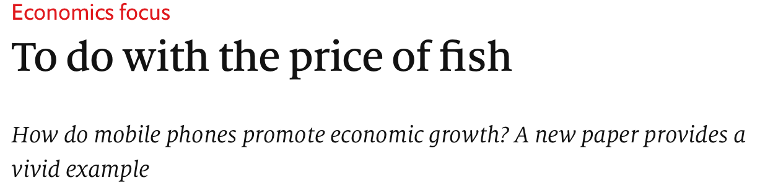
Race Against The Machine
But if humans and machines work together, everyone wins!
https://www.economist.com/finance-and-economics/2007/05/10/to-do-with-the-price-of-fish
A study by economist Robert Jensen found that as soon as mobile telephones became available in the fishing regions of Kerala, India, the price of sardines dropped and stabilized, yet fishermen’s profits actually went up.

Slide 18
Race Against The Machine
What is to be done
Foster a broader class of mid-tech, middle-class entrepreneurs by training them in the fundamentals of business creation and management.
- In the 19th and 20th centuries, as each successive wave of automation eliminated jobs in some sectors and occupations, entrepreneurs identified new opportunities where labor could be redeployed and workers learned the necessary skills to succeed.
- Millions of people left agriculture, but an even larger number found employment in manufacturing and services.

